Slide 1
DEPARTMENT OF COMPUTER SCIENCE GUJARAT UNIVERSITY
HR Management system
Presented By: Vikas Prajapati, Parth Doshi
Guide by : Ms. Jigna satani

Slide 2
Table of Content
Introduction
Objective
Operating Environment
Existing System
Advantages of proposed System
UML Diagrams :-
Use case Diagram
Class Diagram
Activity Diagram
Sequence Diagram
Data Dictionary
Screen shorts
Test cases
Future Enhancement
Limitations of Existing System

Slide 3
Introduction
In this system HR can manage various Employee, Attendance, Leave & Department.
HR and Employee login to system. They can manage and view Different functionalities.
In the epoch of the internet most of the HR work are done via the internet. The company over the internet manage the business & employees to manage the huge number of employees, and with smaller cost than business physically. The most common type of business which has popularity in the now is HR Management System. In this system HR can manage various Employee, Attendance, Leave, Department. HR and Employee login to system. They can manage and view Different functionalities.
HR Management System is delighted to introduce our revolutionary HR Management System, designed to streamline, and optimize every aspect of your organization's human resource functions. Our cutting-edge software is built to empower HR professionals, executives, and employees, making their lives easier and enhancing overall productivity.

Slide 4
Objective
The objective of an HR Management System project is to create a comprehensive software solution that helps streamline various human resources processes and tasks within an organization. This includes managing employee information, attendance, leave, department and more, ultimately aiming to improve efficiency, accuracy, and overall employee management.
The main objective of the project is to develop a website that facilitates the Data storage, Data manage and its retrieval for the HR management system.
The main objective of an HR Management System is to modernize HR practices, enhance efficiency, and create a more engaged and productive workforce, leading to improved organizational performance and long-term success.

Slide 5
Existing System
▪ In Current State they uses typical NTFS (New Technology File System) Processing System. ▪ The System stores permanent records in various files and it needs Sqlite programs to extract records from and add records to the appropriate file and for different functionalities. ▪ They are using Sqlite to store the Employee Personal and Registration Information and also Attendance, Leave details for Better Management.

Slide 6
Proposed System
▪ The Main Aim of the Proposed System is to provide an easy to use Environment to carry out Process. ▪ The Newly Created System is used to Overcome the redundancy of the Existing System. ▪ The Proposed System is a Desktop based application, Created in Django, and provides Form based User Friendly GUI. ▪ With the Use of sqlite database from Application Interface , Database Security is higher compared to Existing System and Prevent Unauthorized users to access the data.

Slide 7
Advantages of Proposed System
▪ More User Friendly Work Environment. ▪ With the use of necessary consistency constraints , data stored in database is consistent and avoids data redundancy. ▪ Report generation based on Admin Requirements is very much easy compared to existing File based system. ▪ Provides easy to search functionality to search specific type of records from Databases. ▪ Provides more Security compared to the Existing System.

Slide 8
Operating Environment
Requirement name | Description
Hardware | Asus vivo book 15
Operating System | Windows
Processors | 11th Gen Intel(R) Core(TM) i5-1135G7
Storage | 8 GB RAM, 512 GB SSD
Software Requirement | VS Code, MySQL, Django
Coding Standard | Website will be developed in Windows and Django framework will be used. Database Management is MySQL.

Slide 9
Types of Users
❖ Admin
❖ HR
❖ Employee

Slide 10
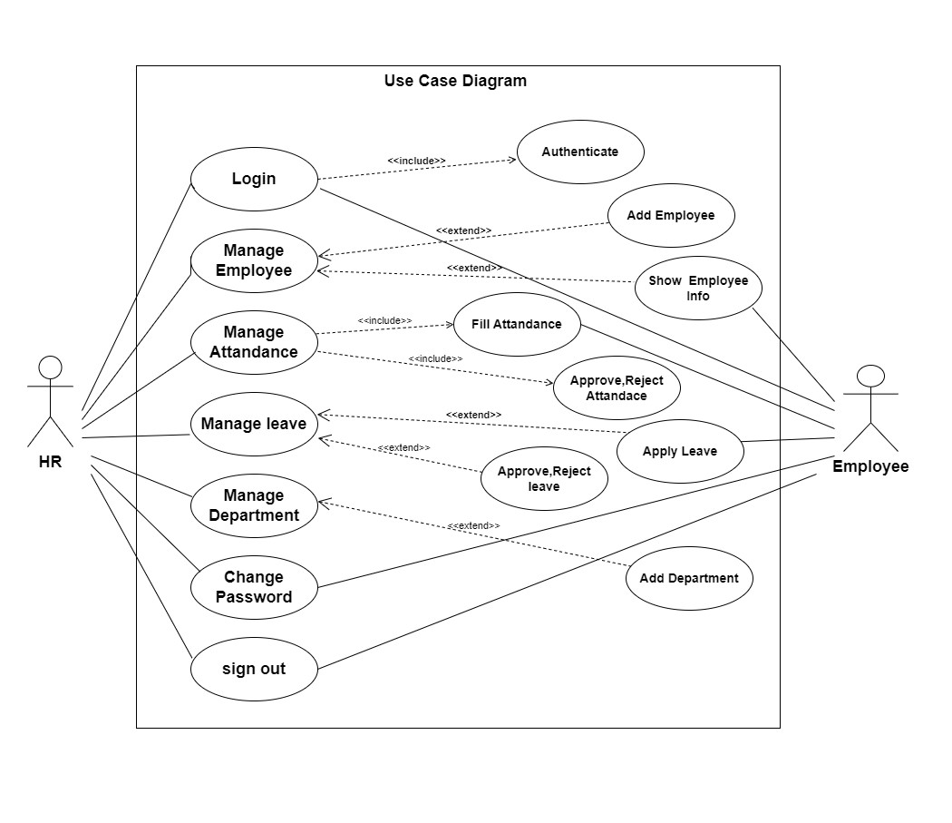
`

Slide 11
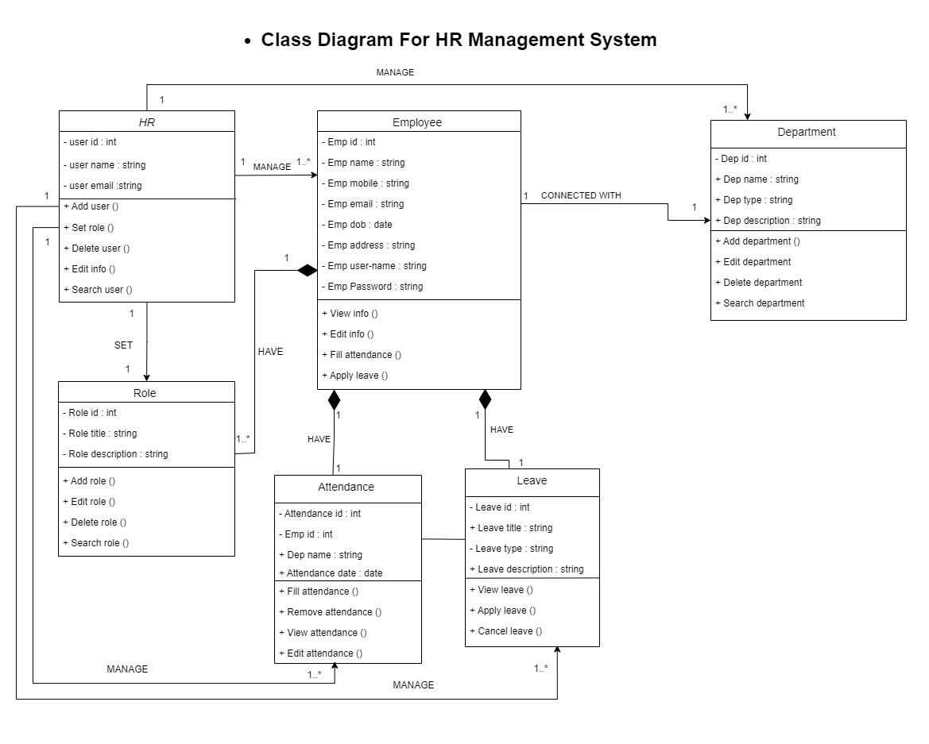

Slide 12
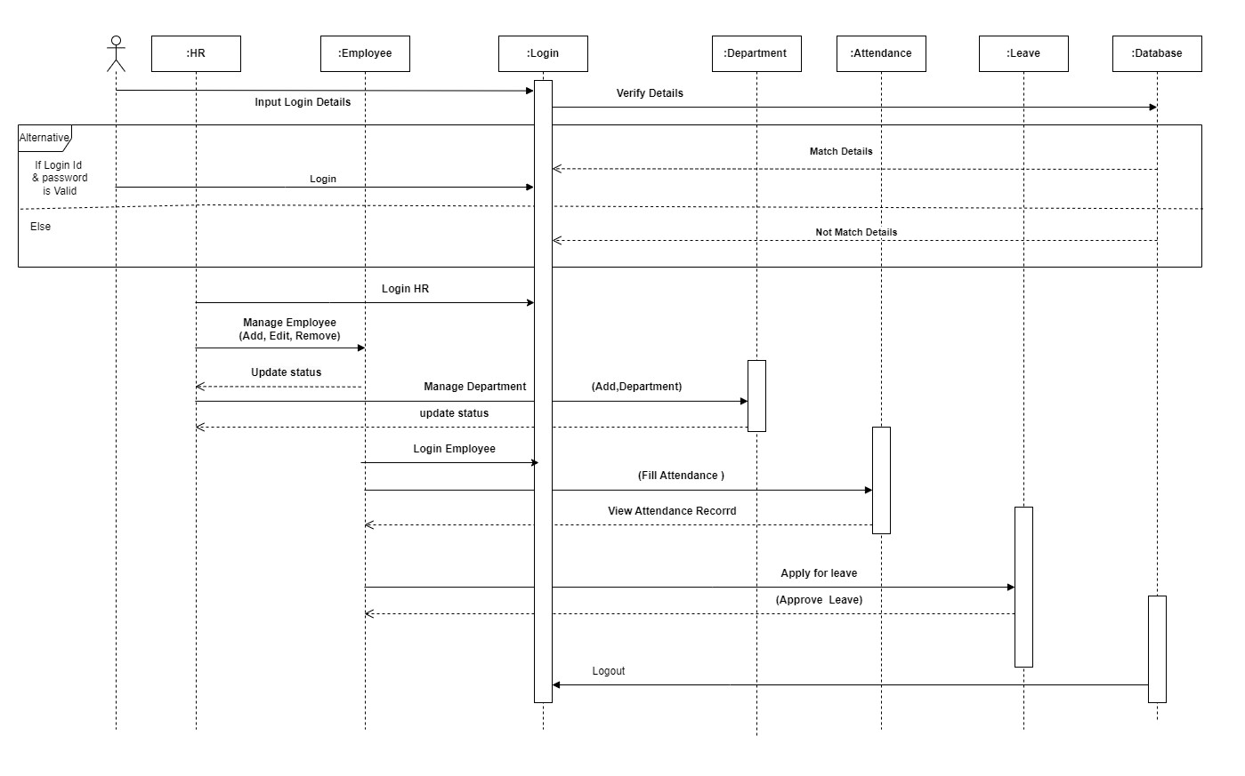
Sequence Diagram

Slide 13
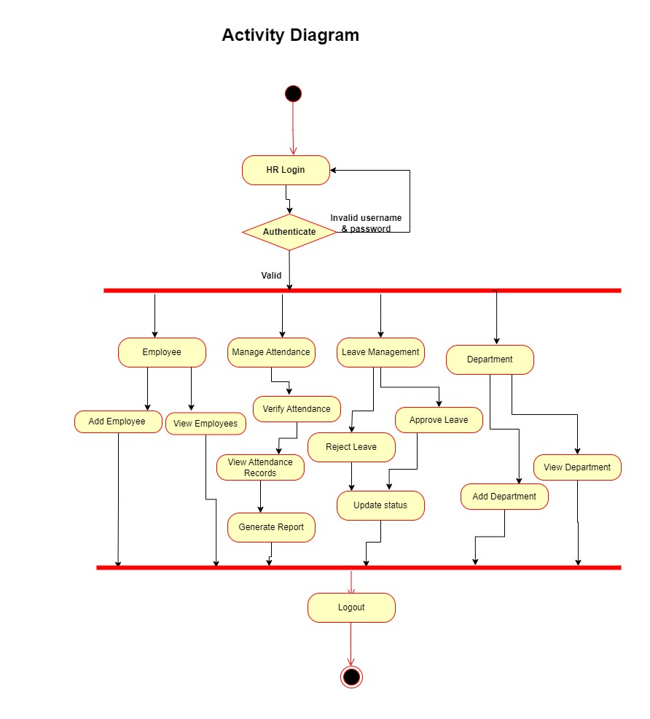

Slide 14
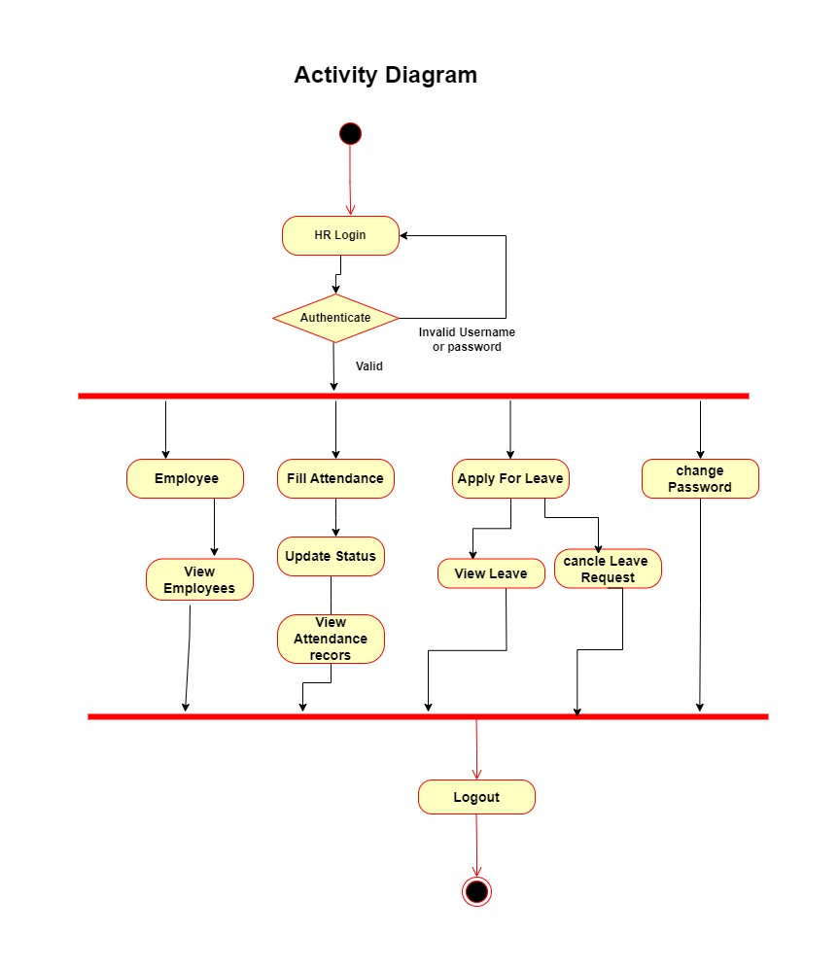

Slide 15
Data Dictionary Table Name: Employee Table purpose: To store the details of Employee
Field name | Data type | Size | Constrains | Purpose
e_id | Integer | 5 | Primary key | To uniquely identified Employee
User | varchar | 20 | Foreign key | To show User of Employee
emp_code | Varchar | 20 | Not null | To identify Employee Through code
Email | Varchar | 20 | Not null | To Store email address of employees
mobile_number | Varchar | 13 | Not null | To Store mobile number of Employees

Slide 16
Continue….
Field name | Data type | Size | Constrains | Purpose
date_of_birth | Date | - | Not null | To Store date of birth employee
employee_address | Varchar | 500 | Default null | To Store address of employees
city_id | Integer | 5 | Foreign key | To store the employee city
state_id | Integer | 5 | Foreign key | To store the employee state
aadhar_number | Varchar | 12 | Default null | To store the employee Aadhar number
pan_number | Varchar | 10 | Default null | To store the employee pan

Slide 17
COUNTINUE…
Field name | Data type | Size | Constrains | Purpose
dep_id | Integer | 5 | Foreign key | To store the employee Department
designation_id | Integer | 5 | Foreign key | To store the Employee designation
date_of_joining | Date | - | Not null | store the date of joining
employee_ty pe | Varchar | 20 | Not null | Full-time, Part-time Trainee, Probation, Commission

Slide 18
.
Table name: Attendance
Table purpose: to store the details about Attendance
Field name | Data type | Size | Constrains | Purpose
att_id | Integer | 5 | Primary key | To uniquely identified attendance id
emp_id | Integer | 5 | Foreign key | To Store the id of employee
att_date | date | - | Not null | store the date of attendance
in_time | time | - | - | To store the time of employee Enter
out_time | time | - | - | To store the time of employee exit

Slide 19
Table name: Attendance Request
Field name` | Data type | Size | Constrains | Purpose
att_request_id | Integer | 5 | Primary key | To uniquely identified request id
emp_id | Integer | 5 | Foreign key | To Store the id of employee
att_date | date | - | - | To Store the attendance employee
in_time | time | - | - | To store the time of employee Enter
out_time | time | - | - | To store the time of employee exit
request_type | varchar | 30 | - | New request, Change request
status | varchar | 20 | Default pending | Approved, Reject, pending
Reason | Text | 200 | Default null | To store reason Employee apsent

Slide 20
Field name | Data type | Size | Constrains | Purpose
leave_id | Integer | 5 | Primary key | To uniquely identified leave id
leavetype_id | Integer | 5 | Foreign key | To Store the id of leave type
emp_id | Integer | 5 | Foreign key | To Store the id of employee
from | date | - | Default null | store the date of leave start date
to | date | - | Default null | store the date of leave end date
num_of_days | Integer | 10 | Default 0 | To store the total Number of leave days
description | Varchar | 200 | Default null | To store description about leave

Slide 21
.
Table name: Leave type
Table purpose: to store the details about Leave type
Field name | Data type | Size | Constrains | Purpose
Leavetype_id | Integer | 5 | Primary key | To uniquely identify Leavetype
Leavetype_name | Varchar | 30 | Not null | Sick leave, Paid leave, Leave without pay, Maternity leave, Paternity leave

Slide 22
.
Table name: Leave
Table purpose: to store the details about Leave
Field name | Data type | Size | Constrains | Purpose
leave_id | Integer | 5 | Primary key | To uniquely identified leave id
leavetype_id | Integer | 5 | Foreign key | To Store the id of leave type
emp_id | Integer | 5 | Foreign key | To Store the id of employee
from | date | - | Default null | store the date of leave start date
to | date | - | Default null | store the date of leave end date
num_of_days | Integer | 10 | Default 0 | To store the total Number of leave days
description | Varchar | 200 | Default null | To store description about leave

Slide 23
.
Table name: Department
Table purpose: to store the details about Department
Field name | Data type | Size | Constrains | Purpose
id | Integer | 5 | Primary key | To uniquely identified Department id
name | varchar | 50 | Not null | To store the department name of employee

Slide 24
.
Table name: Designation
Table purpose: to store the details about Designation
Field name | Data type | Size | Constrains | Purpose
id | Integer | 5 | Primary key | To uniquely identified Designation id
dep_id | Integer | 5 | Foreign key | To store dep id of employee
Dep_name | varchar | 50 | Not null | To store the Designation name of employee

Slide 25
.
Table name: City
Table purpose: to store the details about City
Field name | Data type | Size | Constrains | Purpose
id | Integer | 5 | Primary key | To uniquely identified City id
State_id | Integer | 5 | Foreign key | To store state id of employee
name | varchar | 50 | Not null | To store the City name of employee

Slide 26
.
Table name: State
Table purpose: to store the details about State
Field name | Data type | Size | Constrains | Purpose
id | Integer | 5 | Primary key | To uniquely identified State id
name | varchar | 50 | Not null | To store the State name of employee

Slide 27

Screen shorts

Slide 28
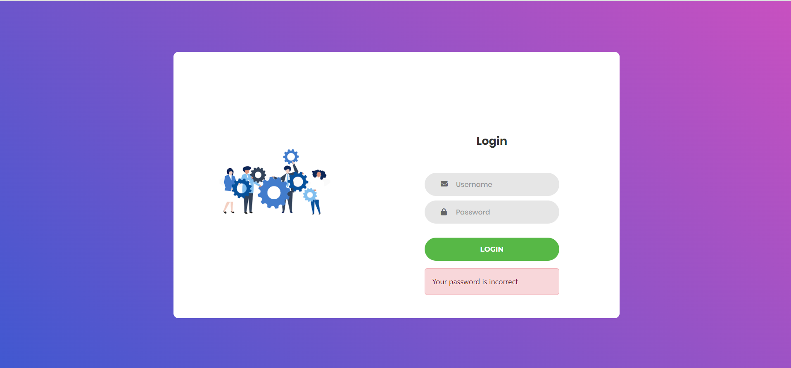

Slide 29


Slide 30
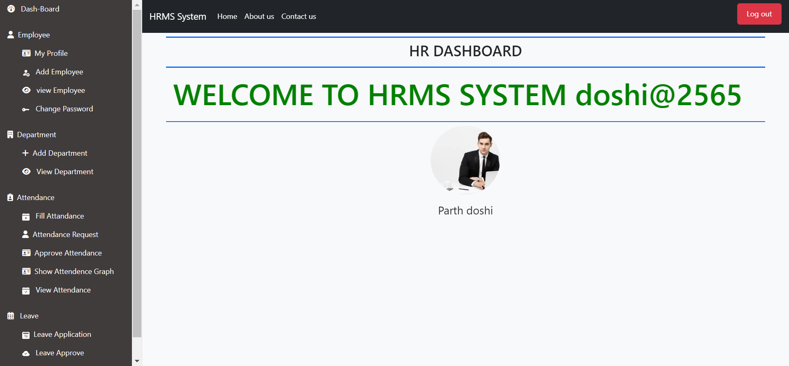
HR Dashboard

Slide 31
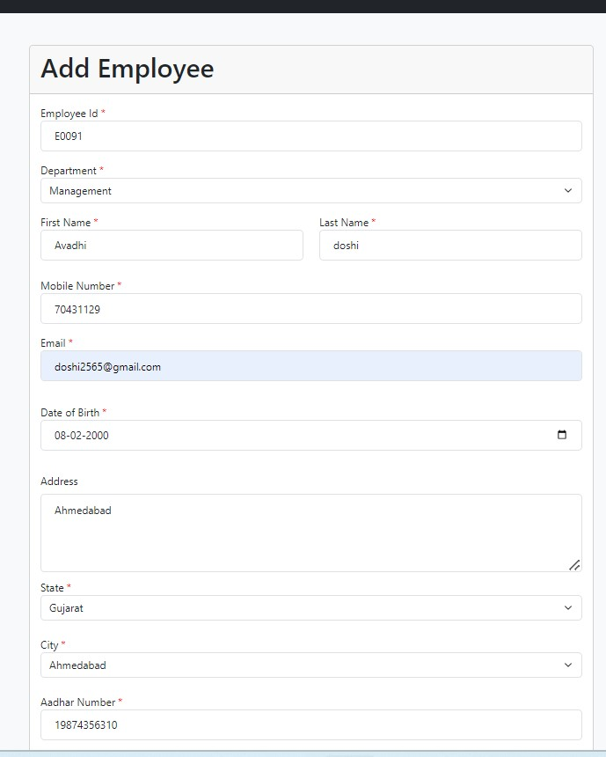

Slide 32
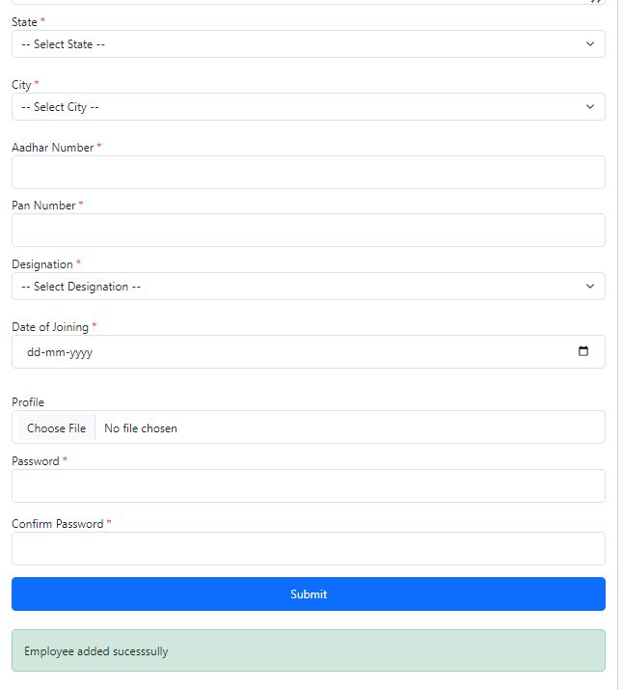

Slide 33
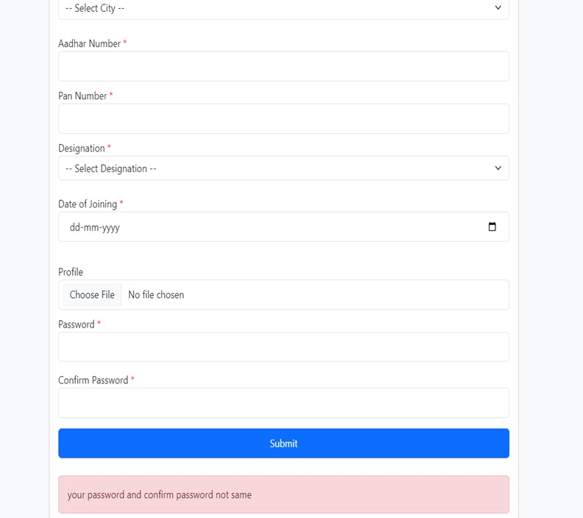

Slide 34
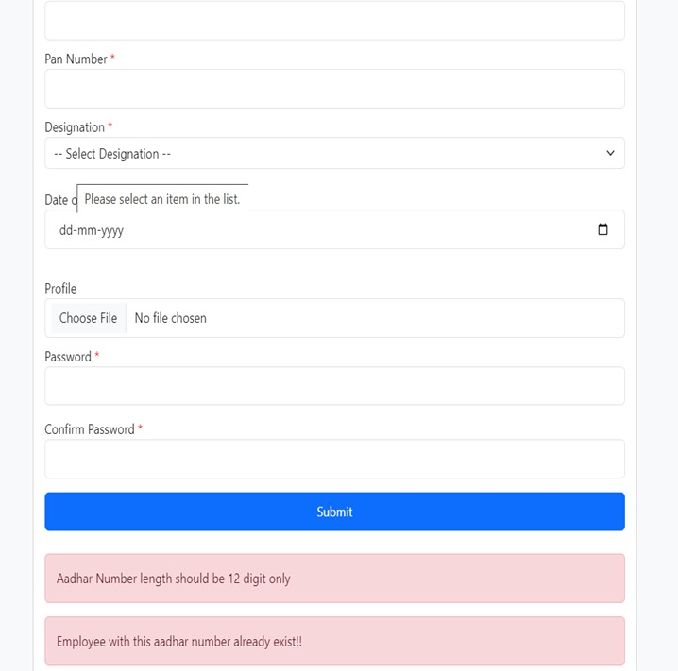

Slide 35
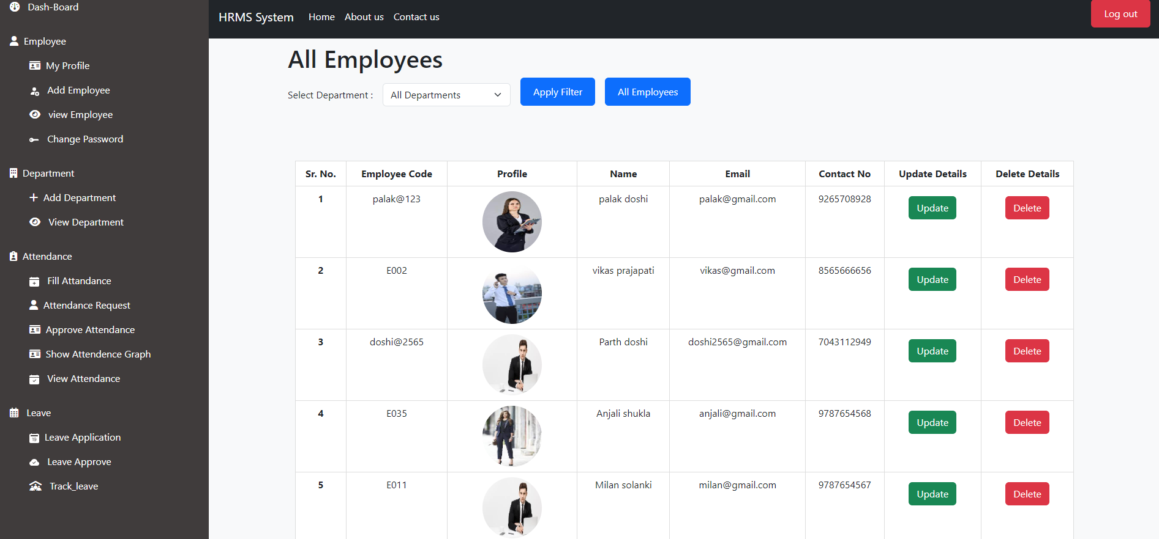

Slide 36
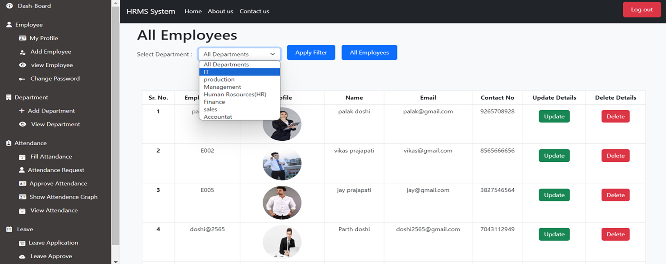

Slide 37
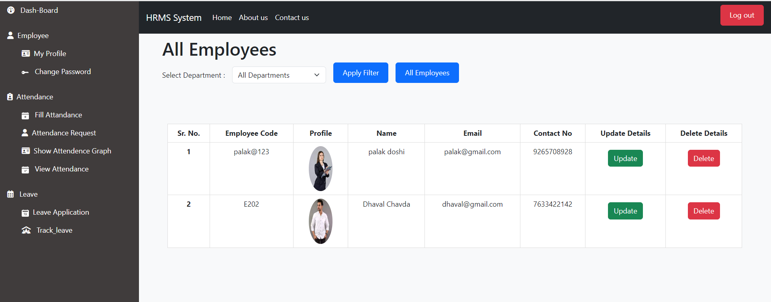

Slide 38
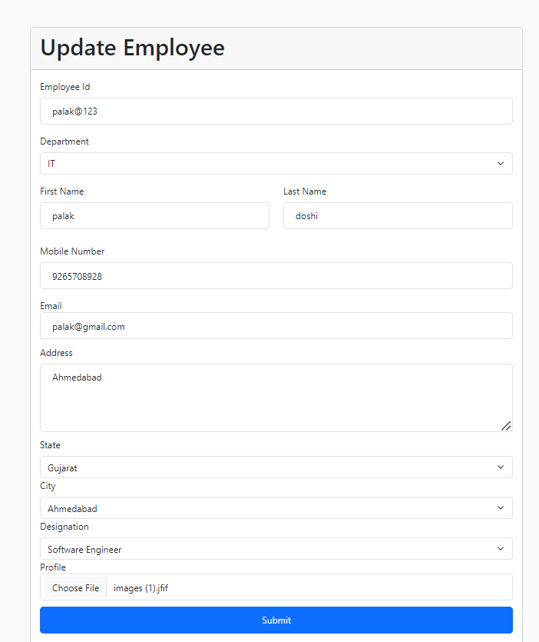

Slide 39
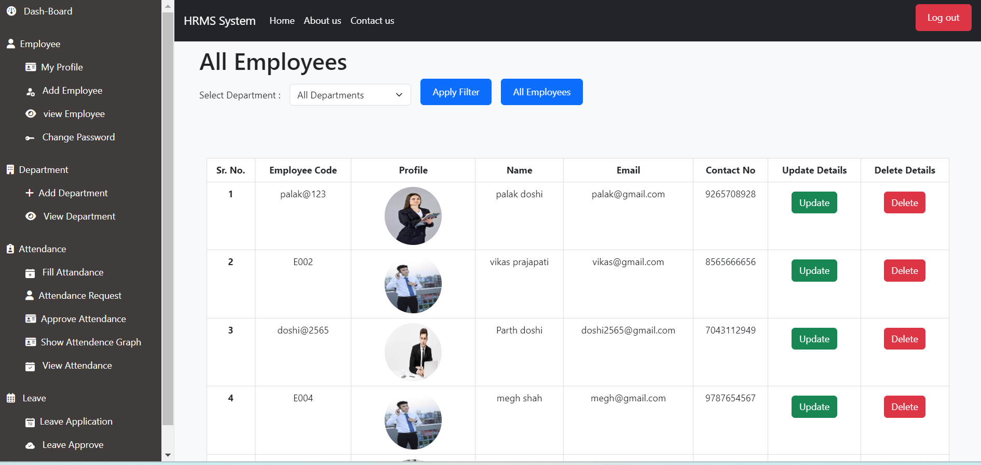

Slide 40
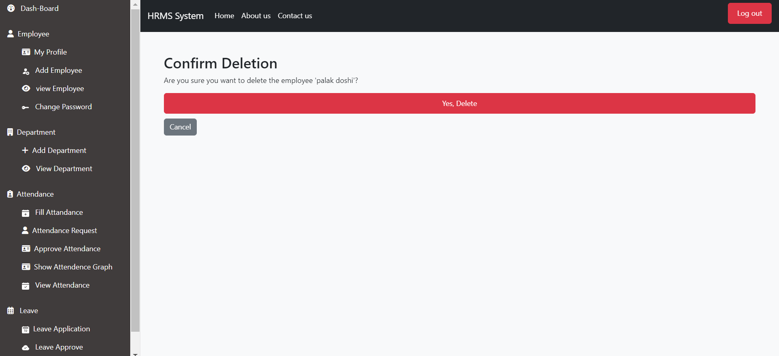

Slide 41
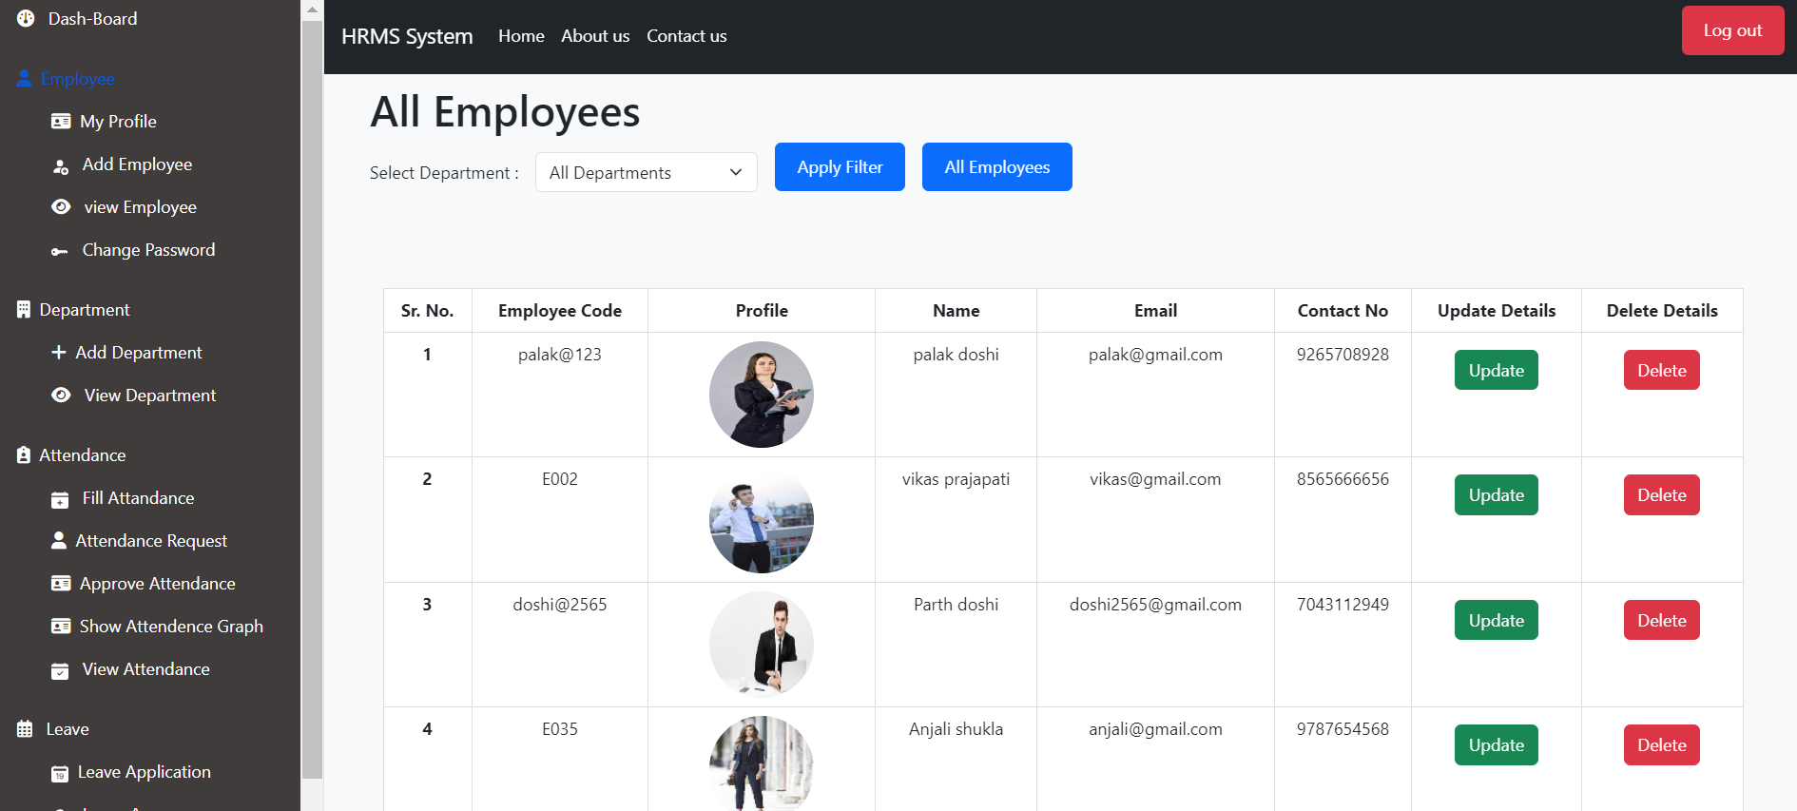

Slide 42
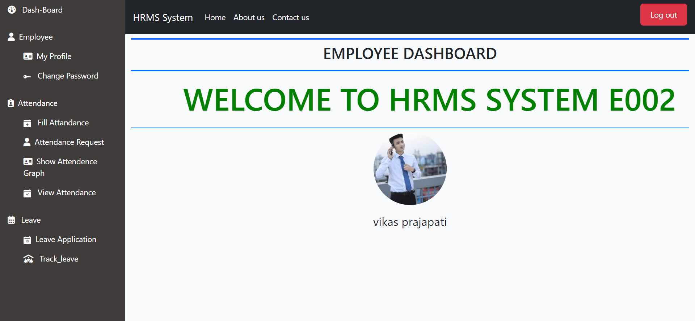
Employee Dashboard

Slide 43
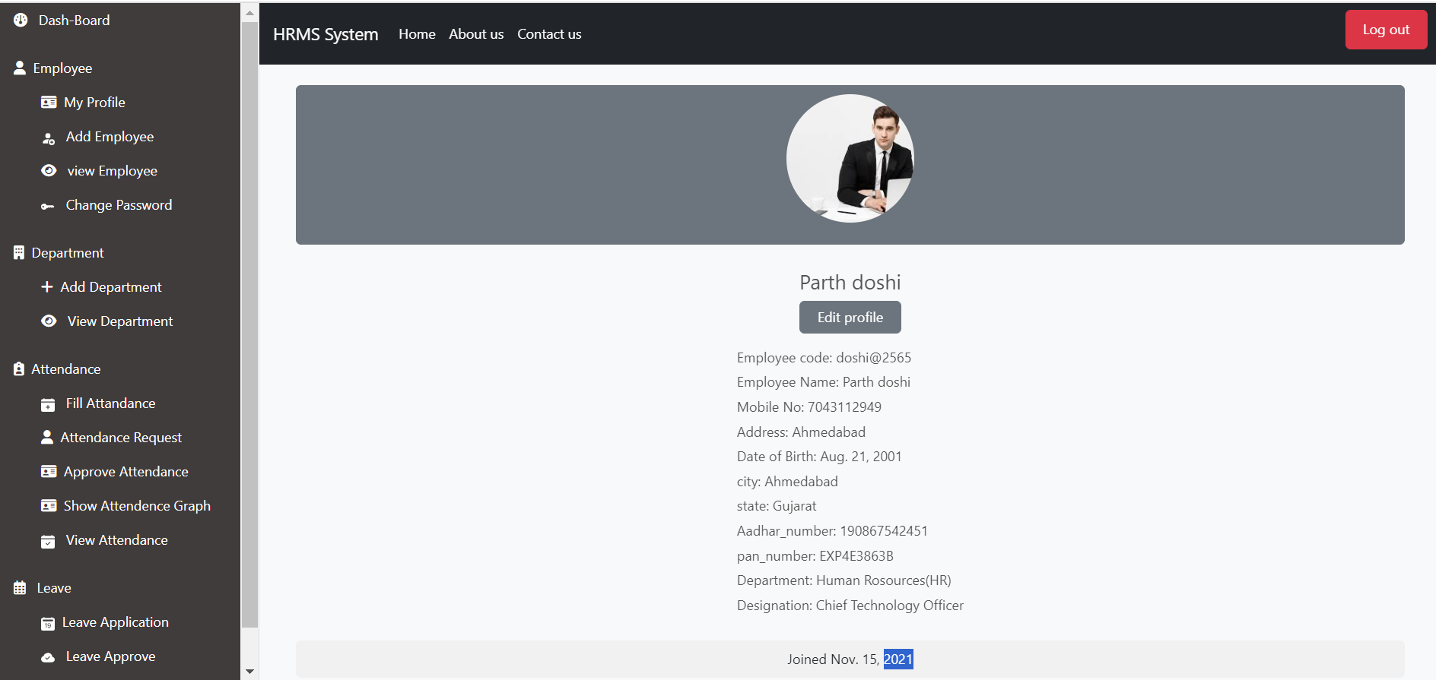

Slide 44
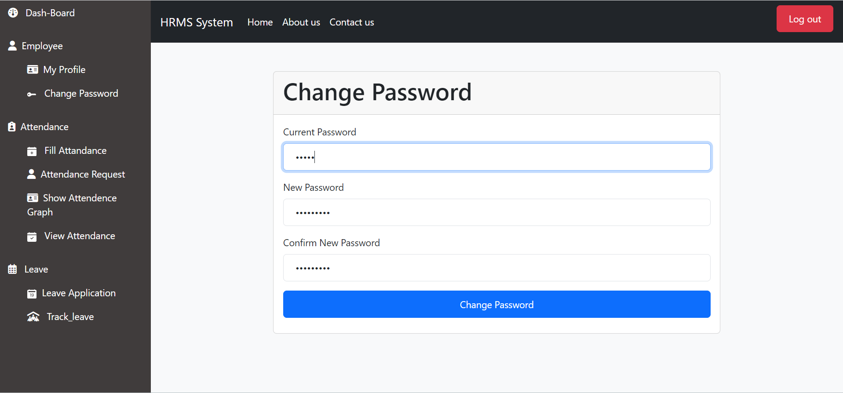

Slide 45
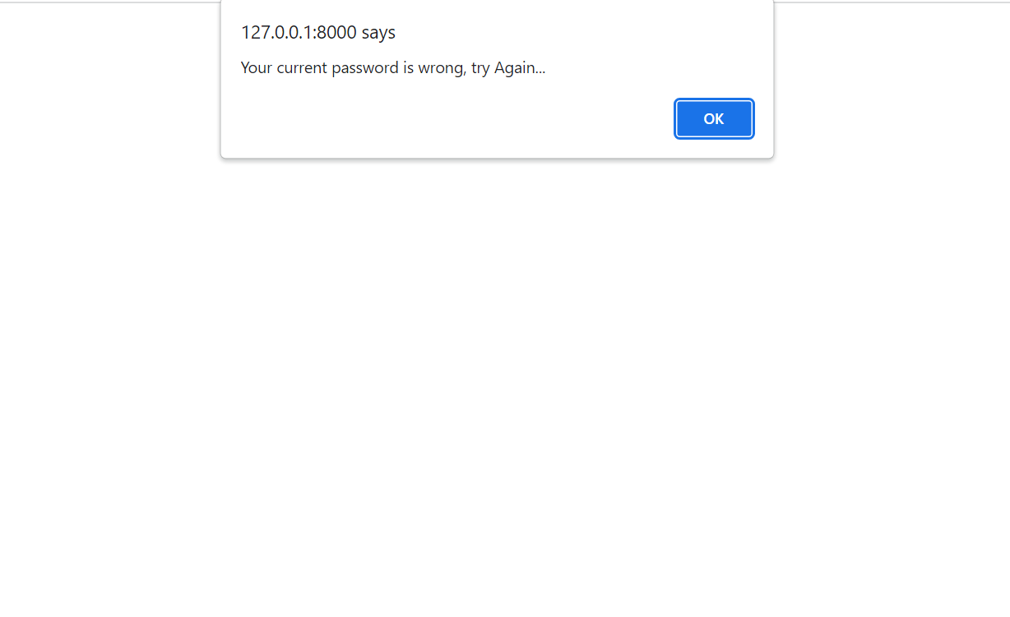

Slide 46
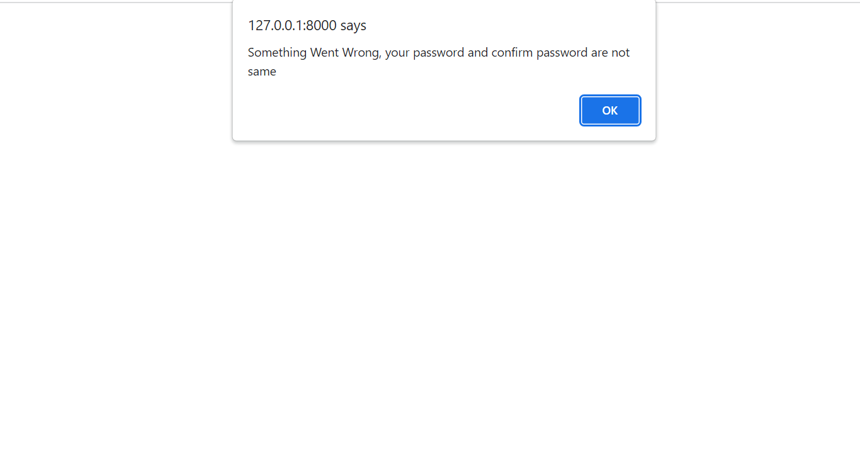

Slide 47
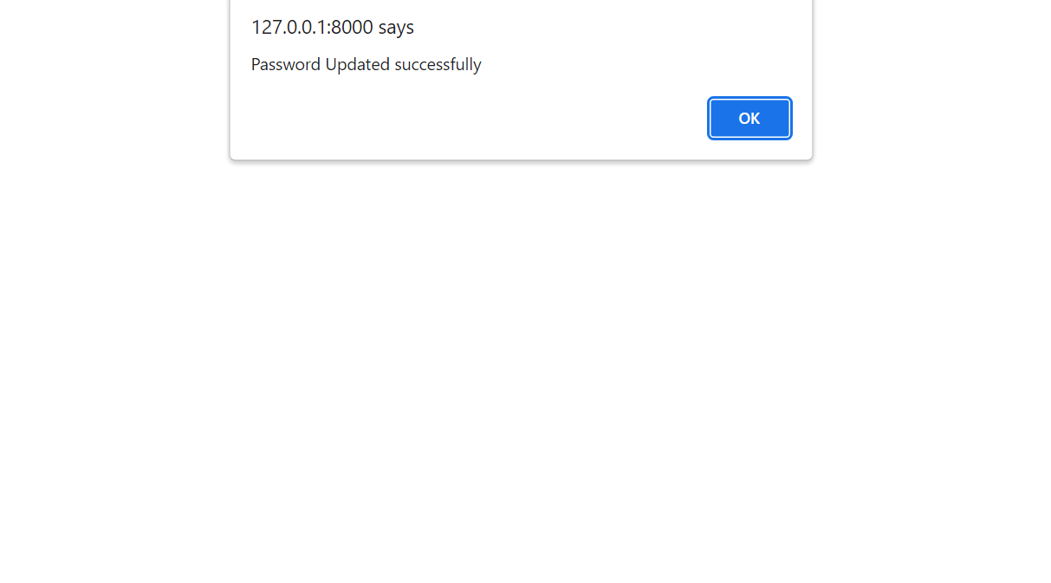

Slide 48
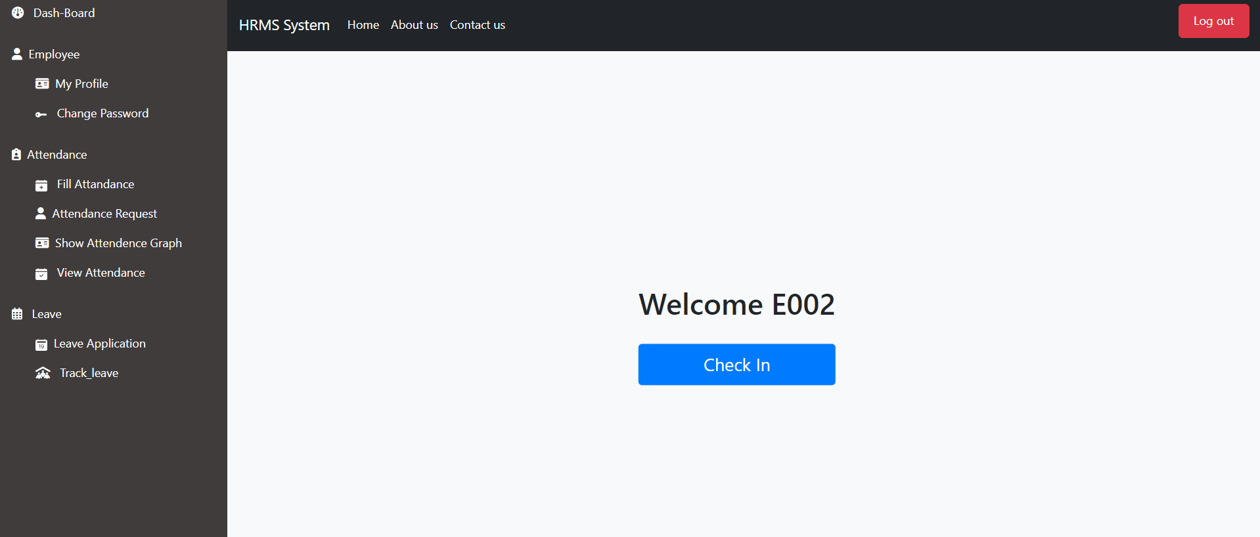
Employee fill Attendance

Slide 49
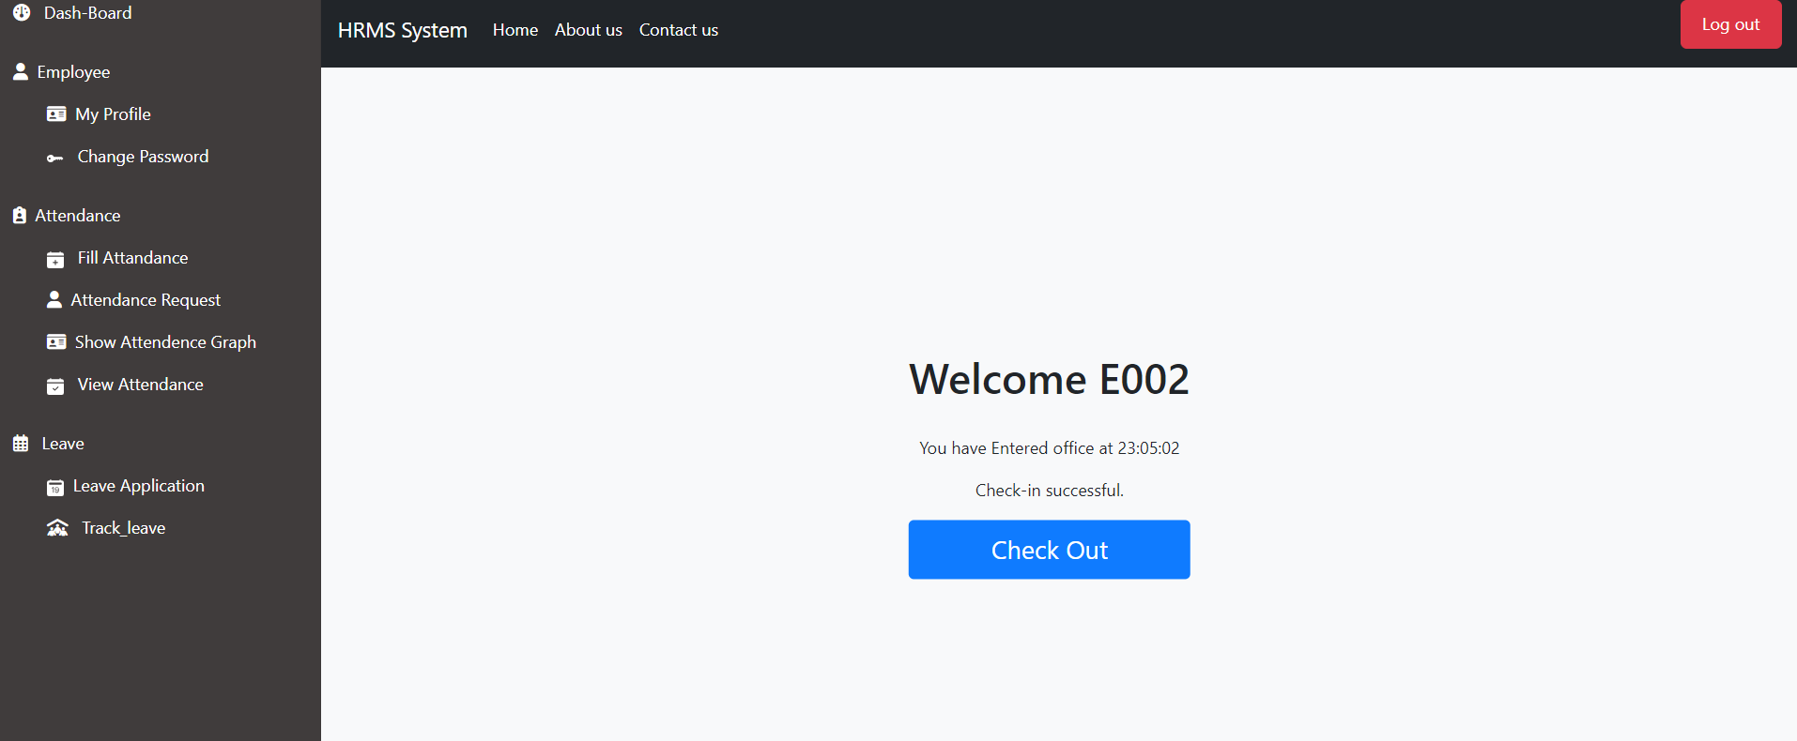

Slide 50
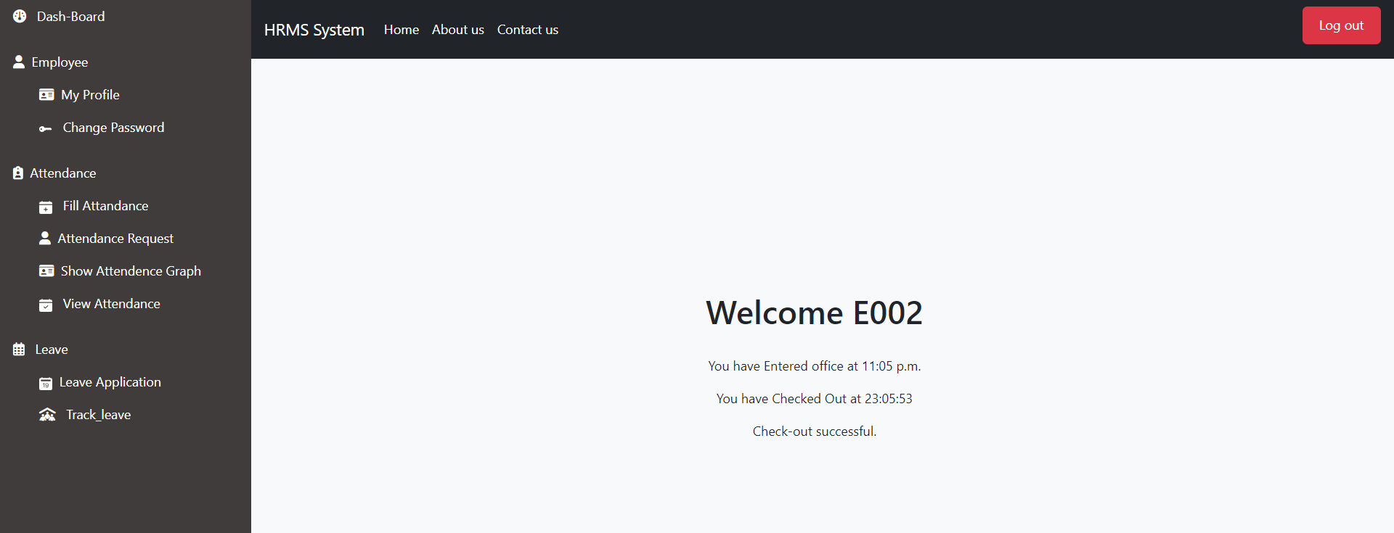

Slide 51
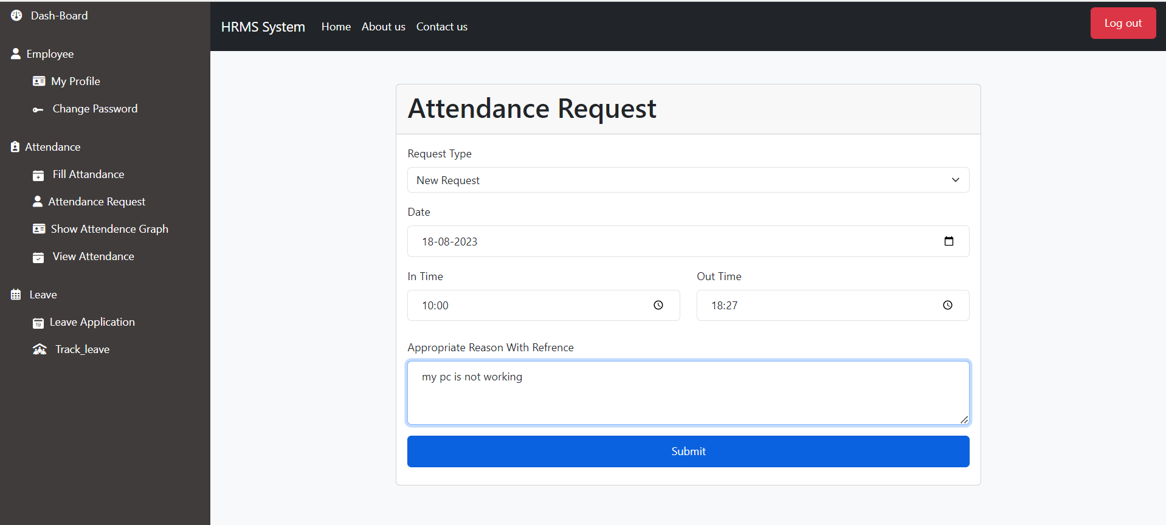

Slide 52
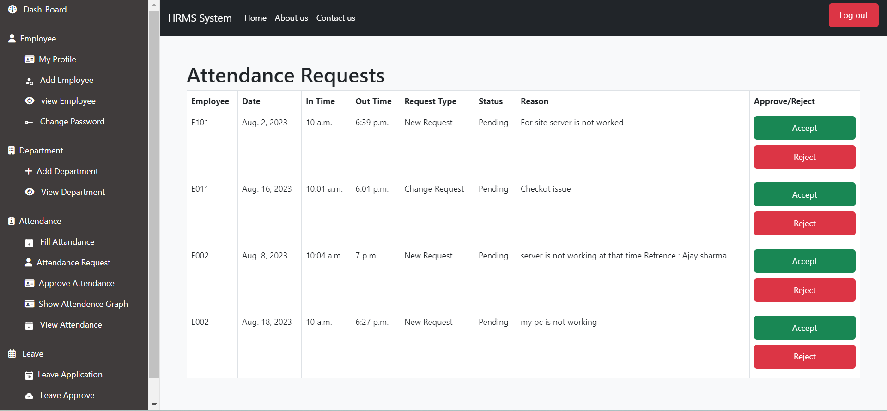
HR Accept And Reject Attendance Request

Slide 53
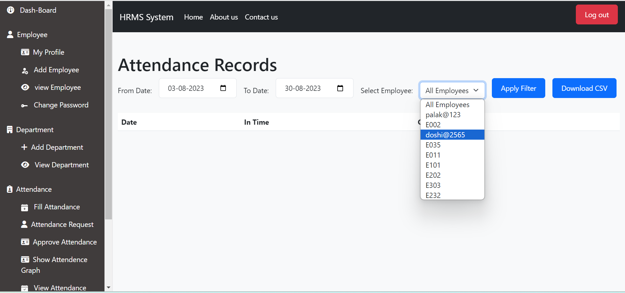

Slide 54
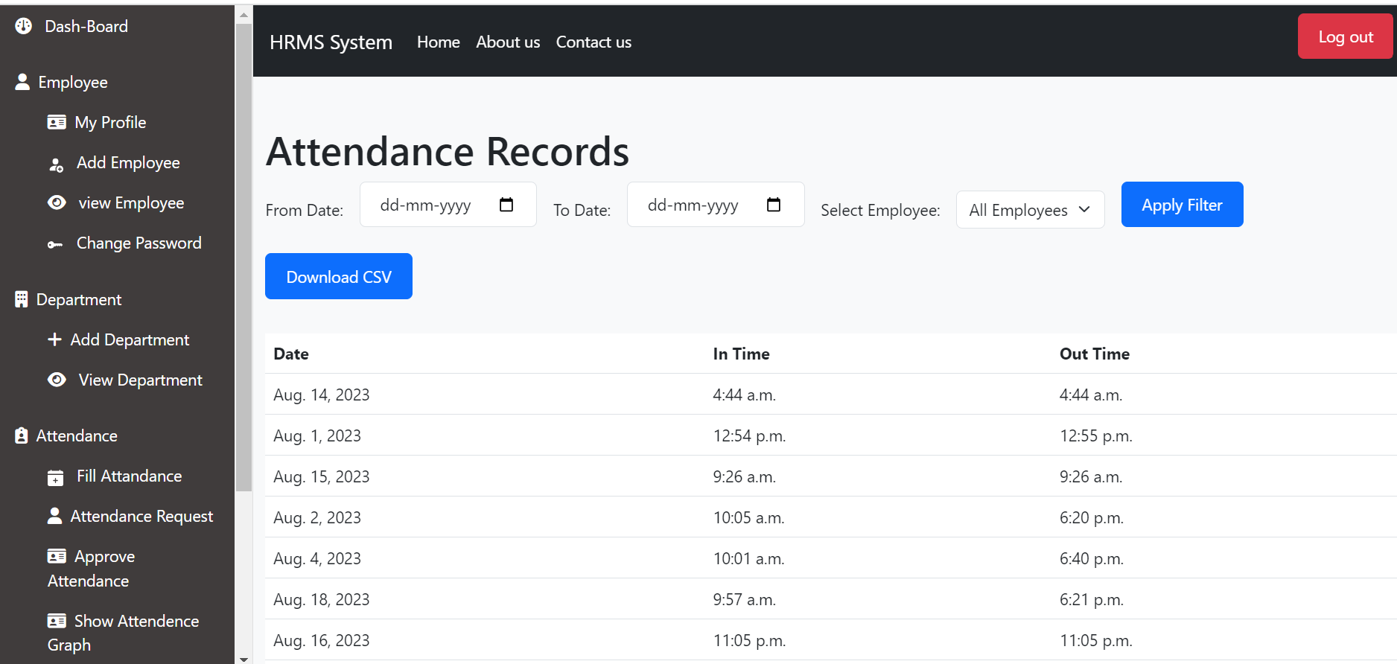

Slide 55
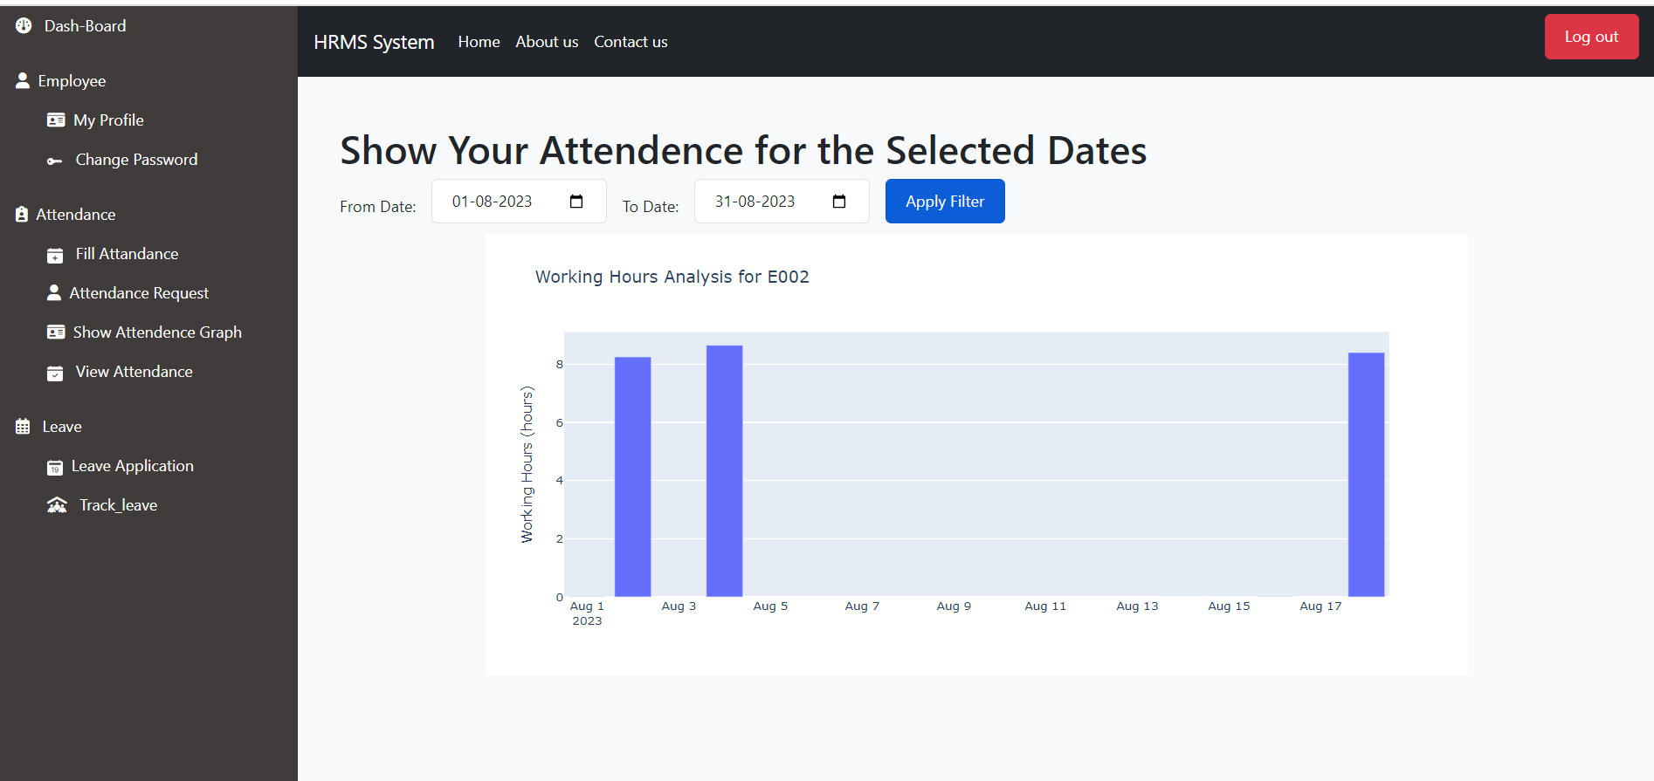
Employee and hr attendance analysis Through graph

Slide 56
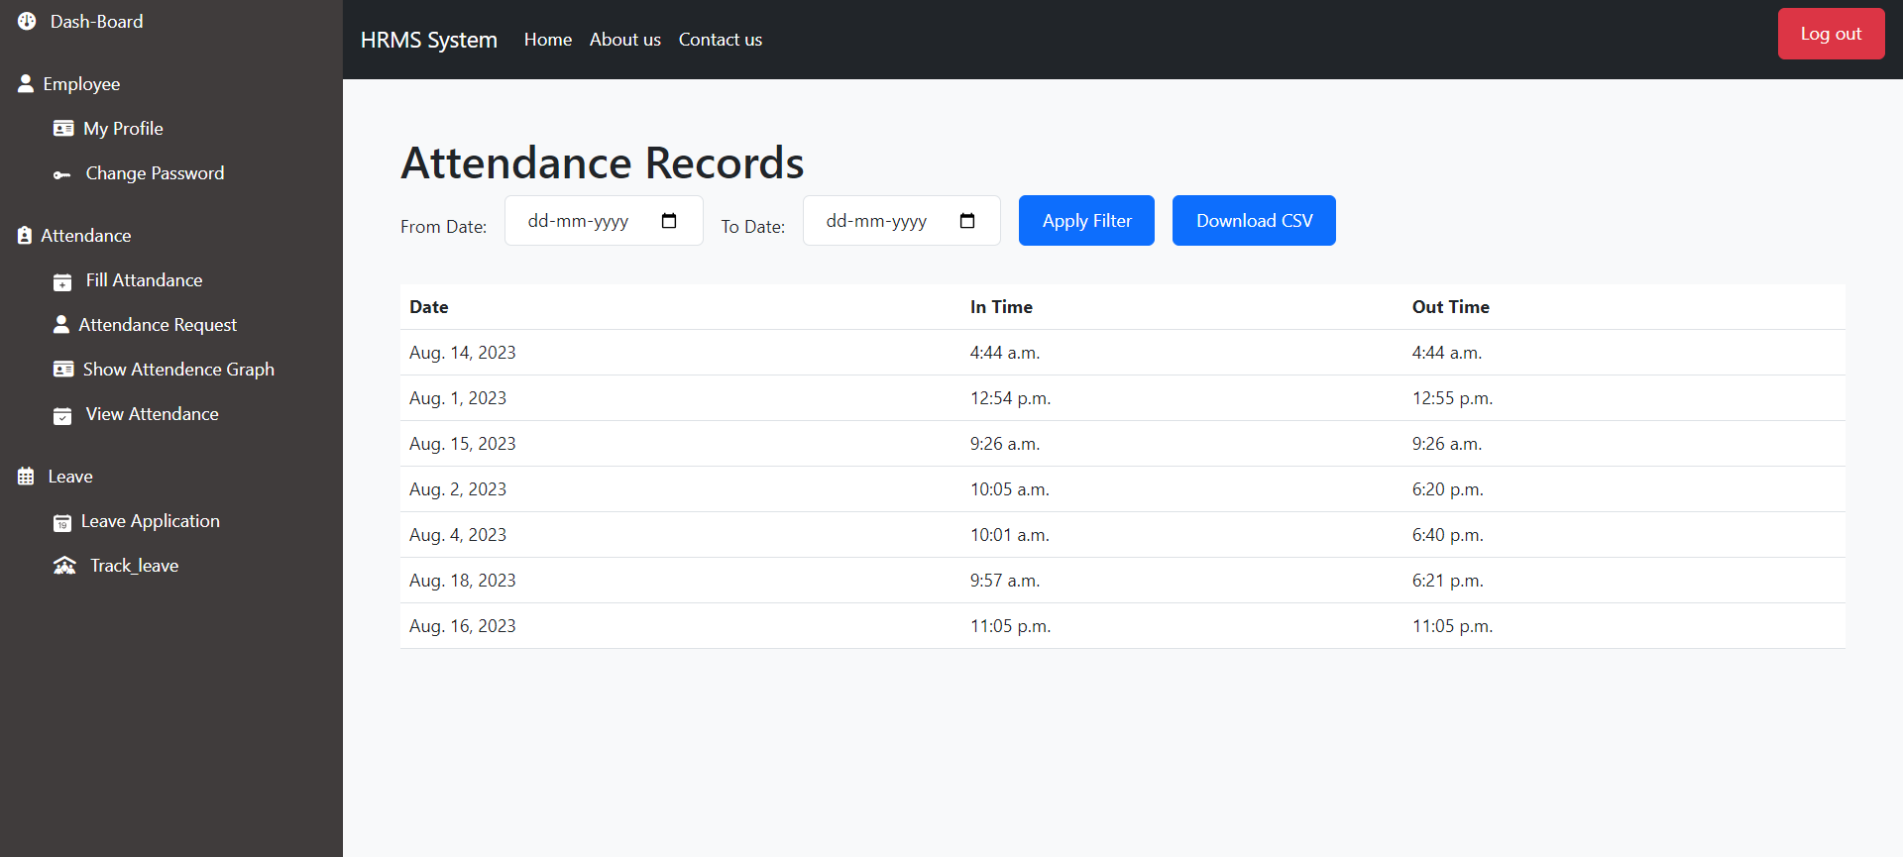

Slide 57
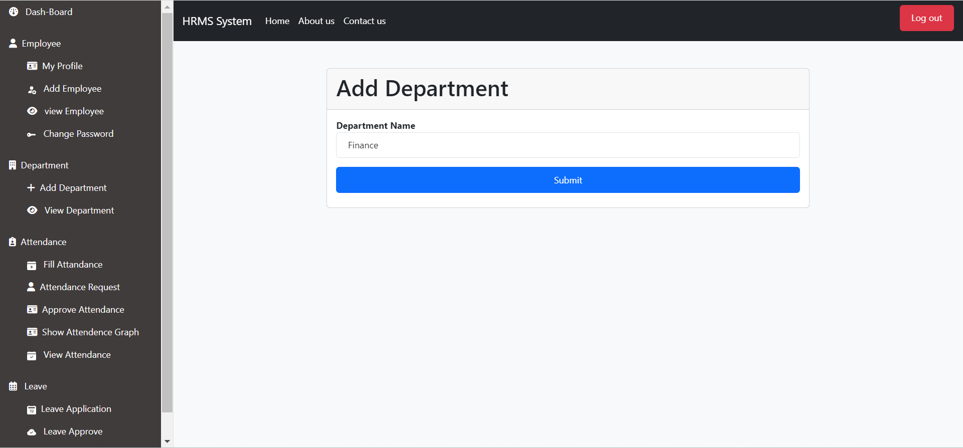
HR Add Department

Slide 58


Slide 59
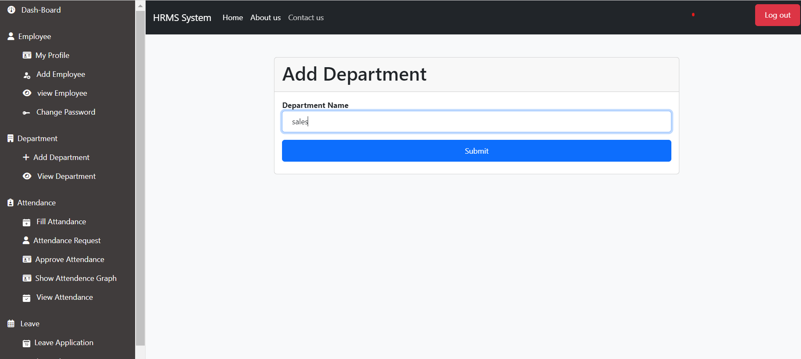

Slide 60
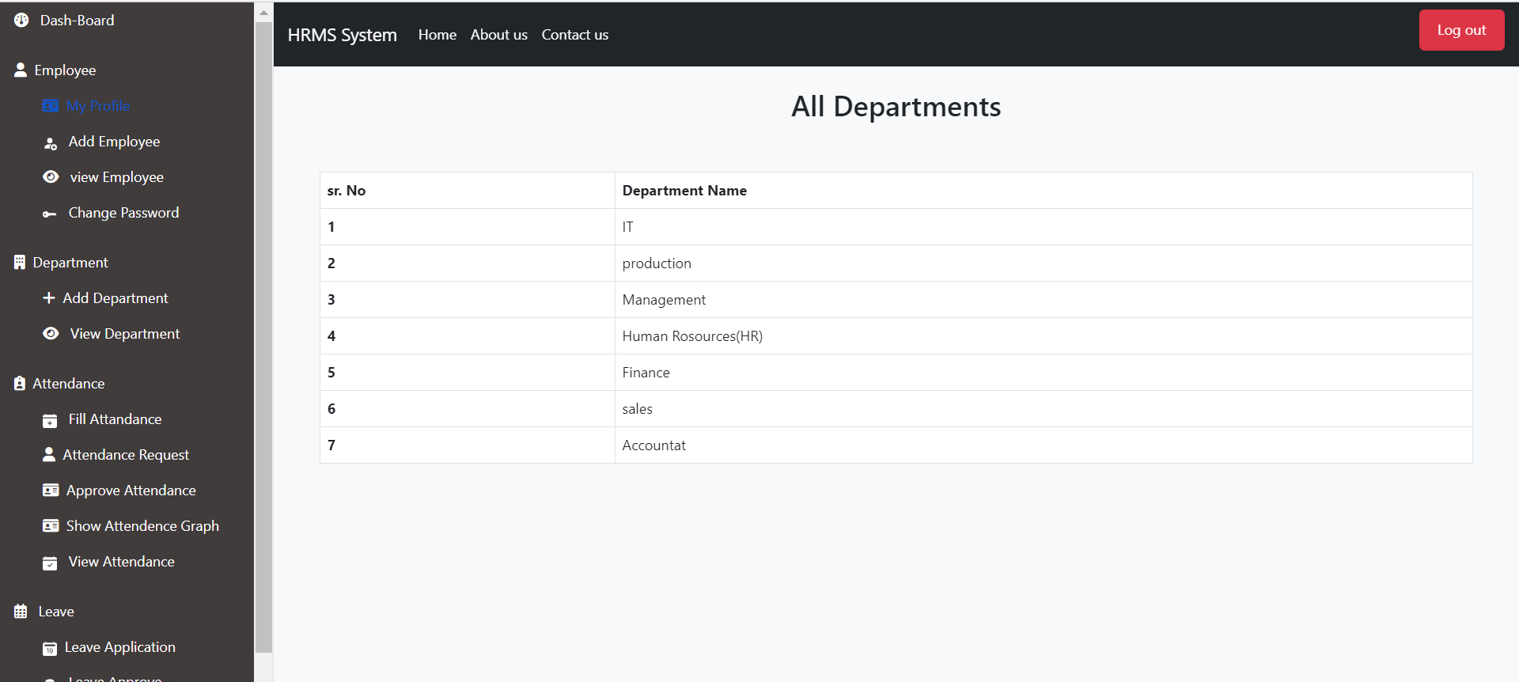

Slide 61
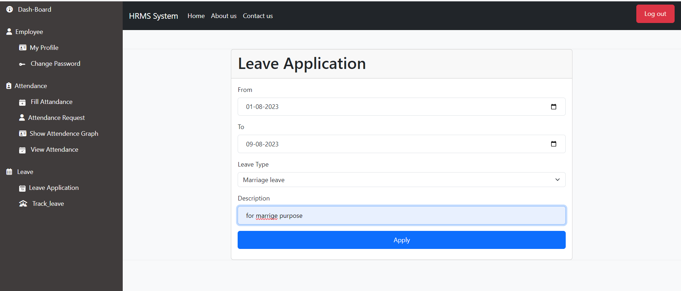
Employee can Apply for leave

Slide 62
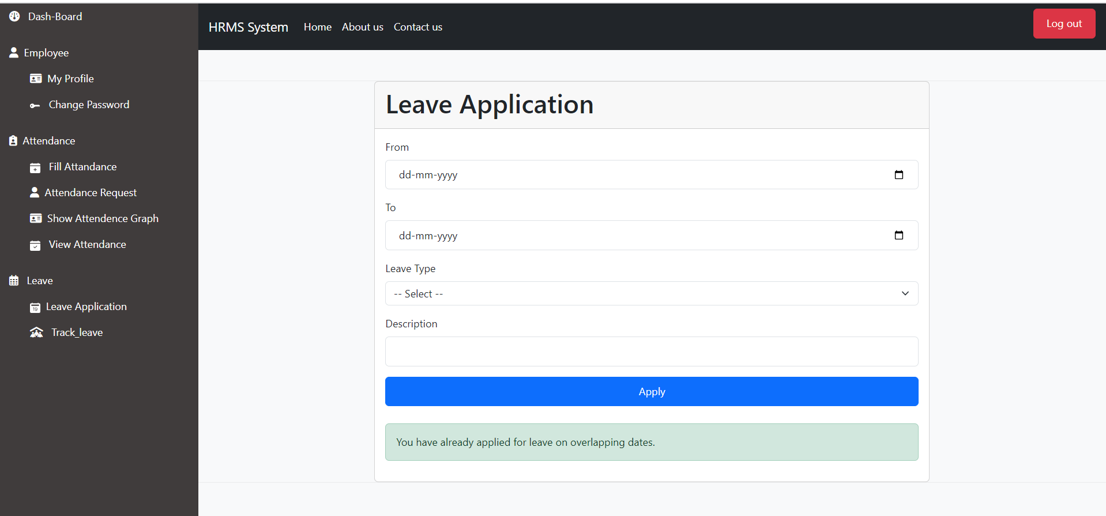

Slide 63
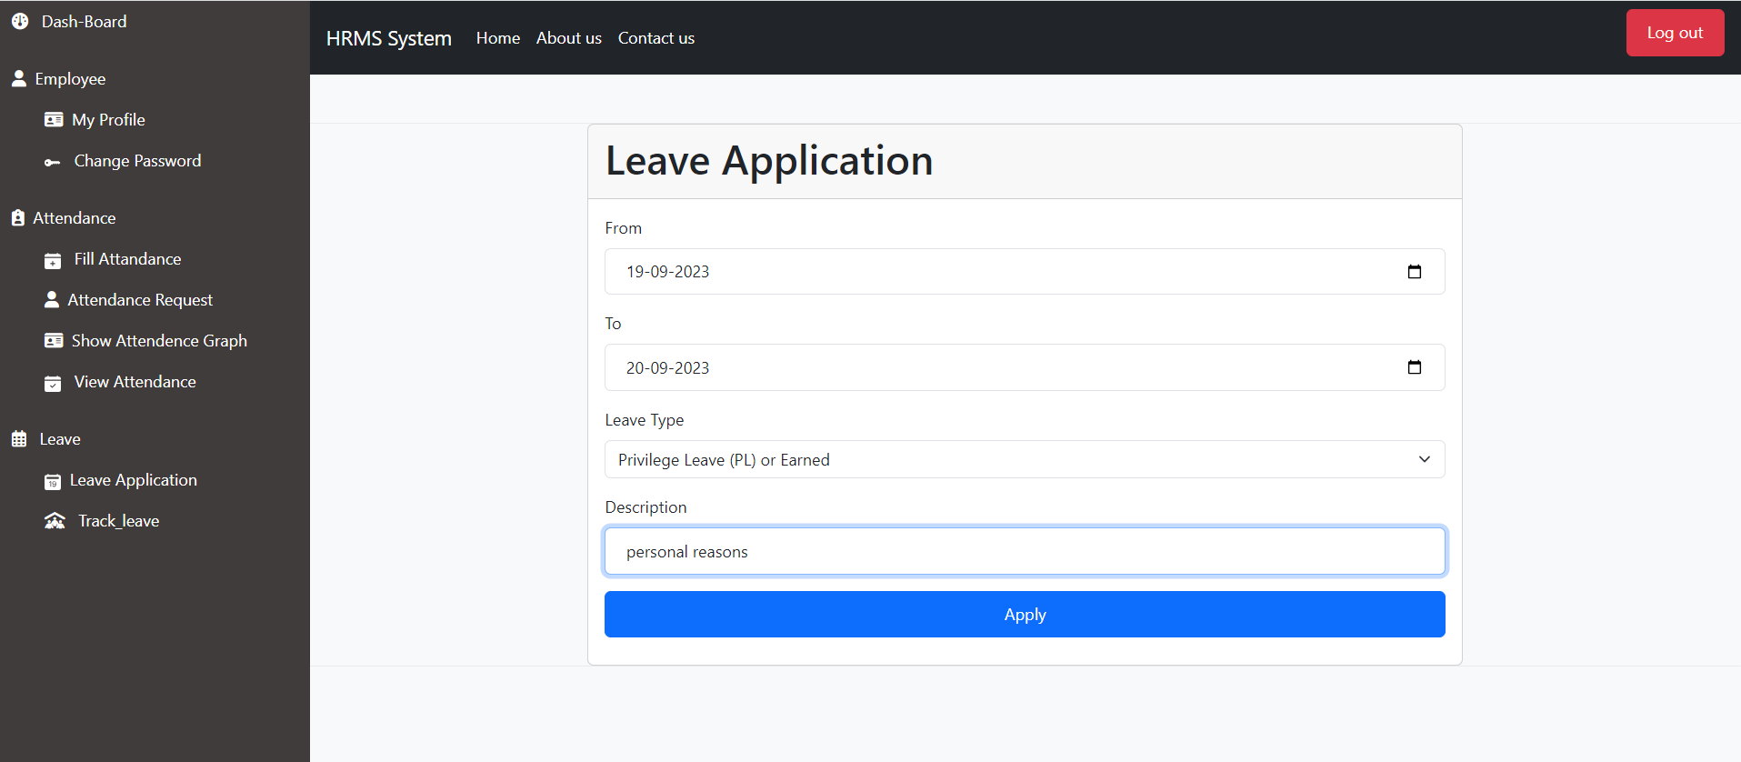

Slide 64
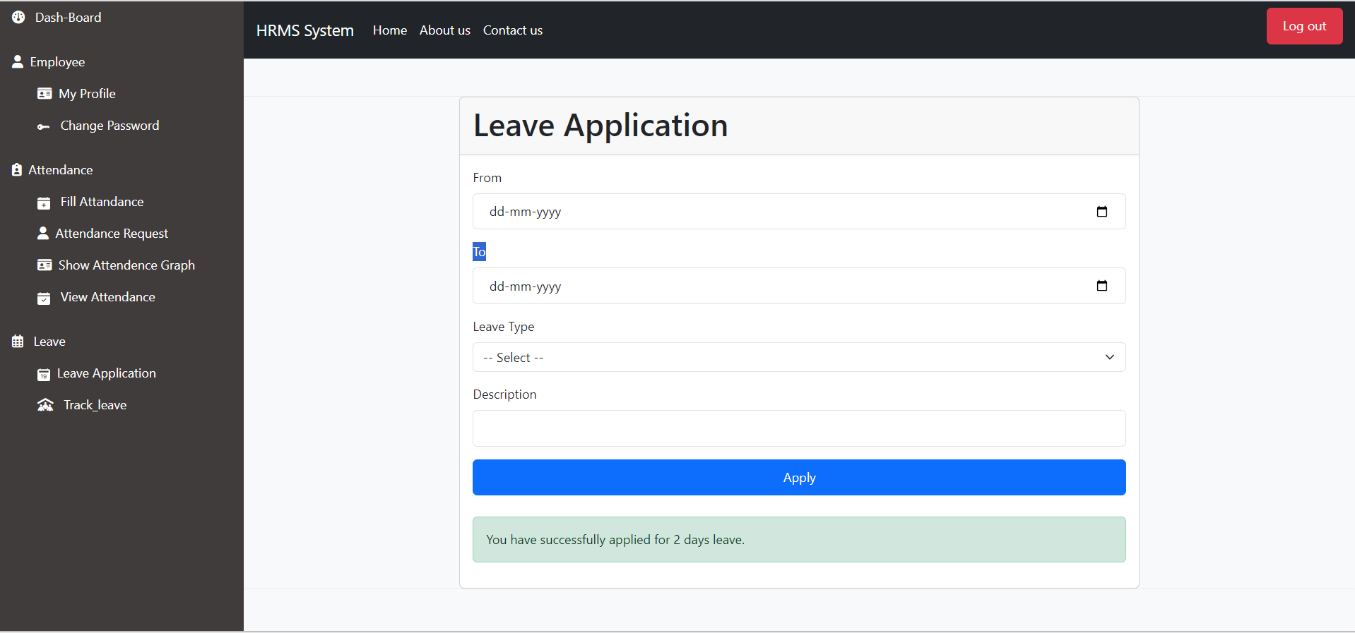

Slide 65
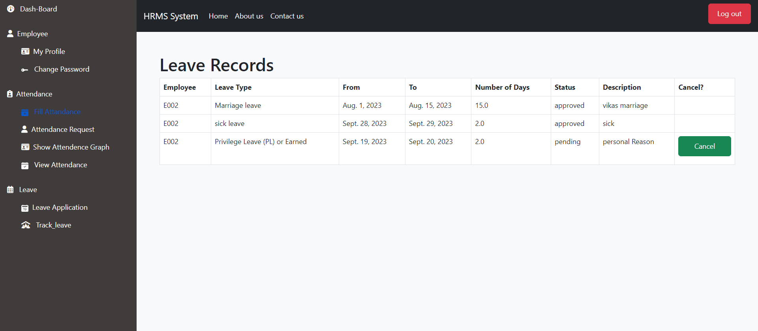

Slide 66
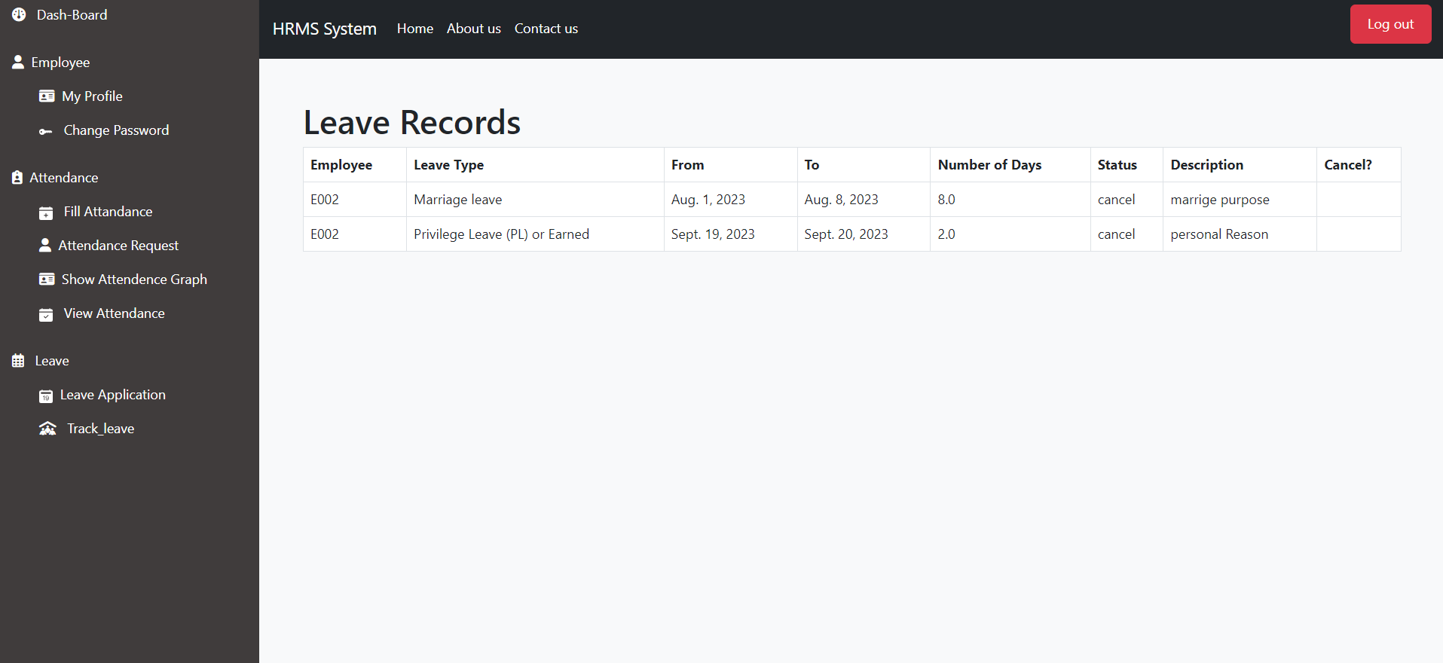

Slide 67
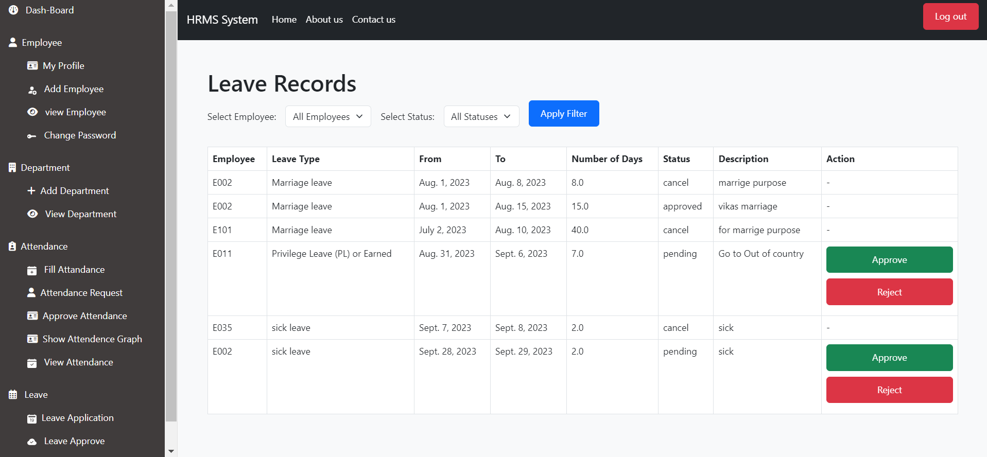

Slide 68
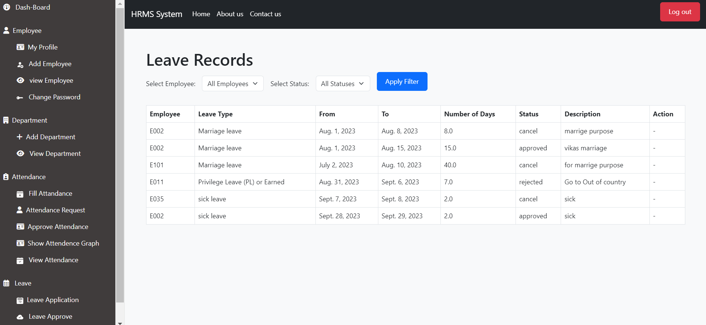

Slide 69
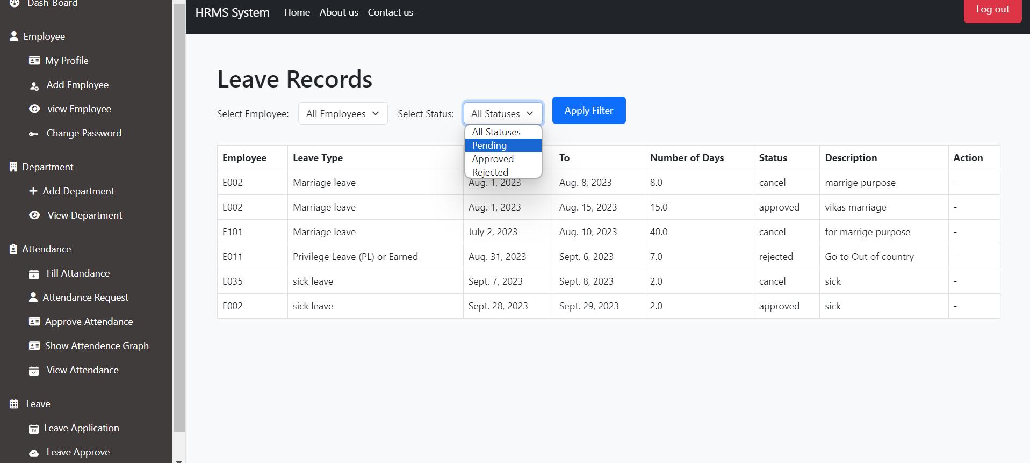

Slide 70
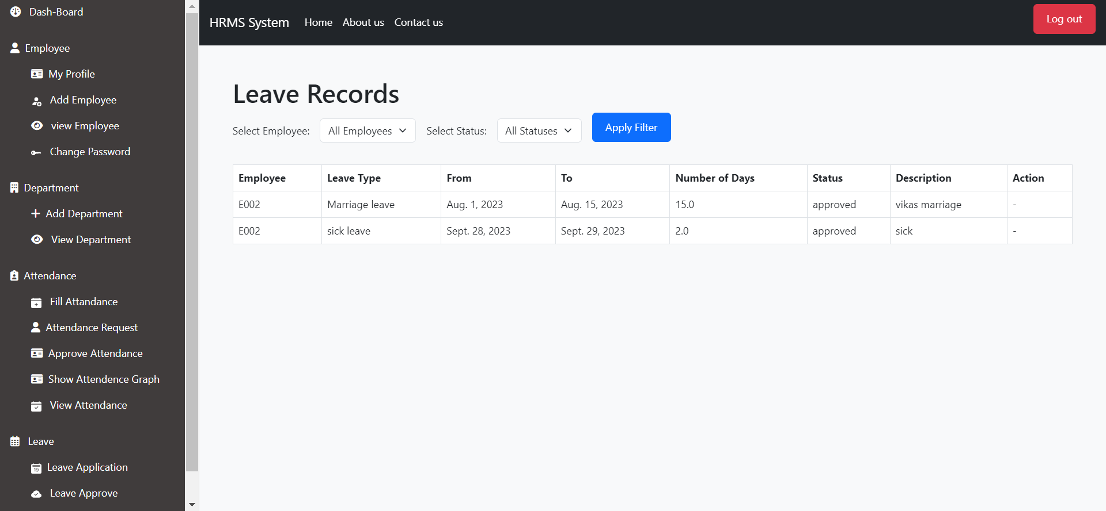

Slide 71
Test Cases
Test Case ID | 1
Test Case Name | Validation For “Password”
Input Data | Incorrect Password
Expected Output | Message “Your Password is incorrect”
Actual output | As Expected

Slide 72
Test Case ID | 2
Test Case Name | Validation For “Username”
Input Data | Incorrect Username
Expected Output | Message “Your Password is incorrect”
Actual output | As Expected
Test Case ID | 3
Test Case Name | Validation For “Username”
Input Data | Incorrect Username
Expected Output | Message “Your Password is incorrect”
Actual output | As Expected

Slide 73
Test Case ID | 4
Test Case Name | Option on “submit” Button click
Input Data | Valid Employee data(With all Information)
Expected Output | Message “Employee Added Successfully”
Actual output | As Expected
Test Case ID | 5
Test Case Name | Validation For “Confirm Password”
Input Data | Password and confirm Password
Expected Output | Message “Your Password and confirm password not same”
Actual output | As Expected

Slide 74
Test Case ID | 6
Test Case Name | Validation For “Aadhar number”
Input Data | Aadhar number 13 digit and already used
Expected Output | Message “Aadhar number 12 digit and already used”
Actual output | As Expected
Test Case ID | 7
Test Case Name | Validation For ”Email Address”
Input Data | Without email Address
Expected Output | Message “please add @ in email address”
Actual output | As Expected

Slide 75
Test Case ID | 8
Test Case Name | Option on ”Update” button click
Input Data | valid details
Expected Output | Redirect view employee Page
Actual output | As Expected
Test Case ID | 9
Test Case Name | Option on ”Delete” button click
Input Data | Valid data
Expected Output | Message “Delete Employee and Redirect view Employee page”
Actual output | As Expected

Slide 76
Test Case ID | 10
Test Case Name | Validation For ”current password”
Input Data | Invalid current Password
Expected Output | Message “please Enter correct current password”
Actual output | As Expected
Test Case ID | 11
Test Case Name | Validation For ”leave application”
Input Data | Date is already applied for leave selected date
Expected Output | Message “You have already applied for leave overlapping days”
Actual output | As Expected

Slide 77
Test Case ID | 12
Test Case Name | Validation For ”leave application”
Input Data | Valid leaves date
Expected Output | Message “you have successfully applied (days) days eaves”
Actual output | As Expected
Test Case ID | 13
Test Case Name | Validation For ”leave status”
Input Data | Accept, Reject
Expected Output | Message “update status and redirect current page”
Actual output | As Expected

Slide 78
Future Enhancement
❖ Advanced Reporting and Analytics
❖ Integration with Payroll Systems
❖ Compliance and Leave Regulations
❖ Flexible Work Arrangement Support
❖ Compliance and Leave Regulations

Slide 79
Limitations of an Existing System
▪ To generate Reports, they have to fetch data manually. ▪ HR has to write each and every detail manually for adding employee that’s why its time consuming and tedious job. ▪ Search Functionality is inefficient to retrieve data as per their requirements. ▪ Data Security is Poor.

Slide 80
Thank You

